Slide 1









ZURA
TOUCH
Founders: Diogo Gomes & Dinis Gomes
www.zuratouch.pt info@zuratouch.pt
+351 931 708 796
Porto, Portugal

Slide 2



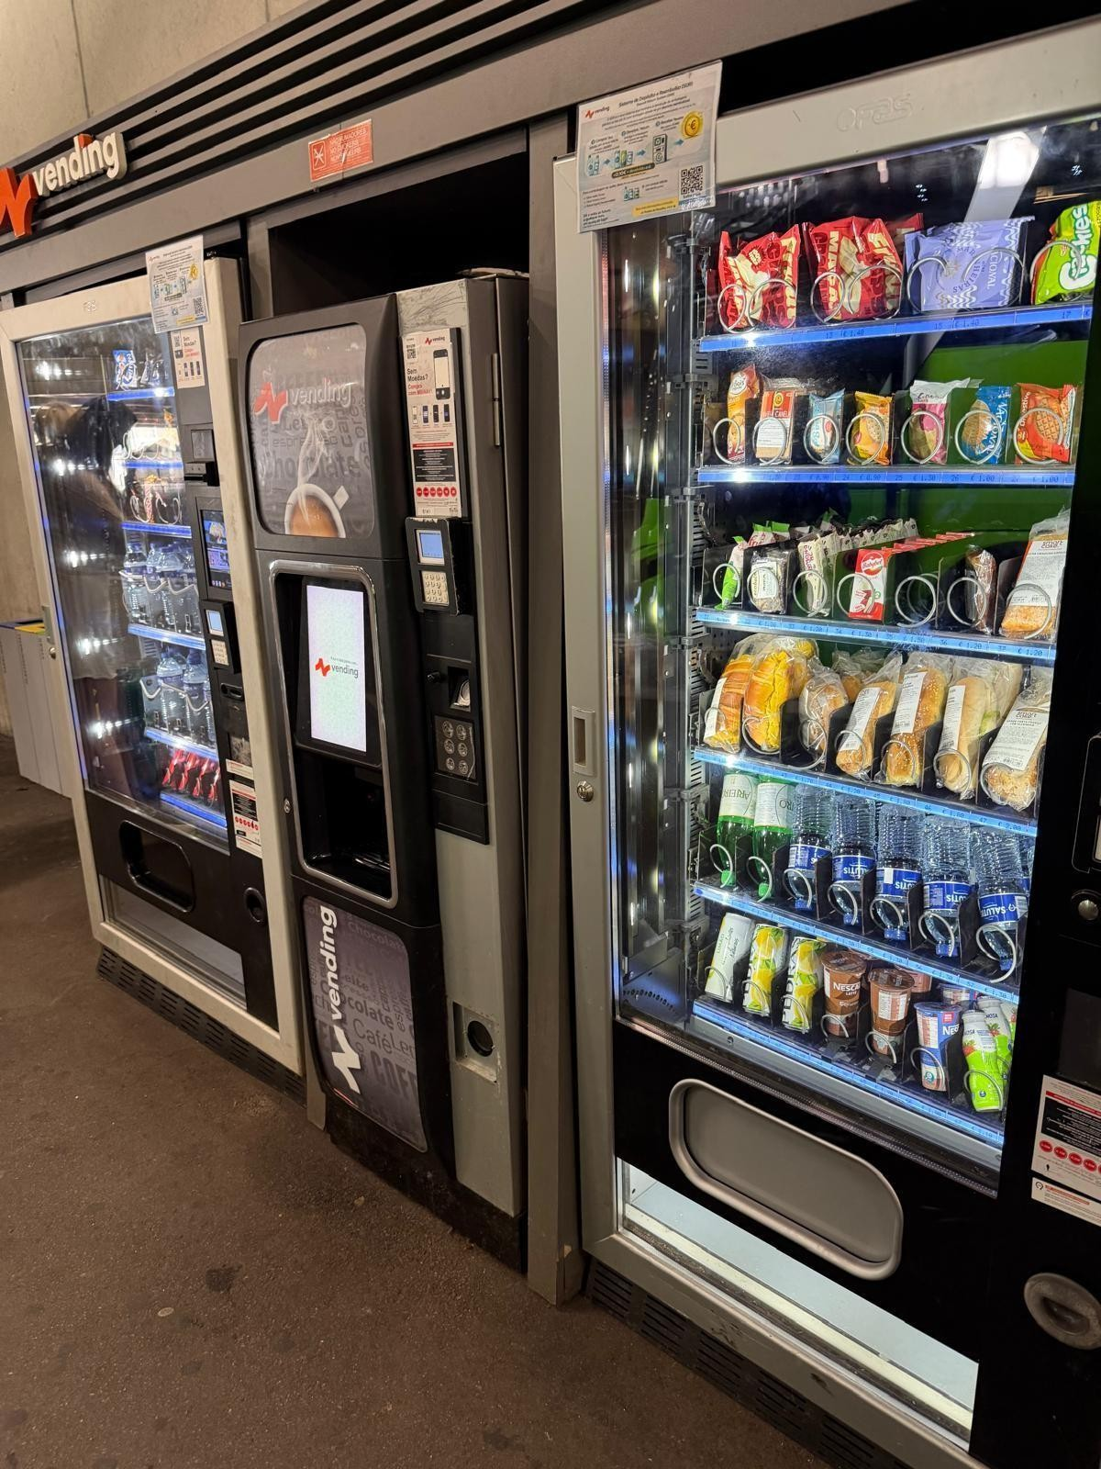





THE PROBLEM
TRADITIONAL VENDING THAT DOESN’T STAND OUT
LACK OF TECHNOLOGICAL INNOVATION
LOW PROFIT MARGINS FOR VENDING OPERATORS

Slide 3



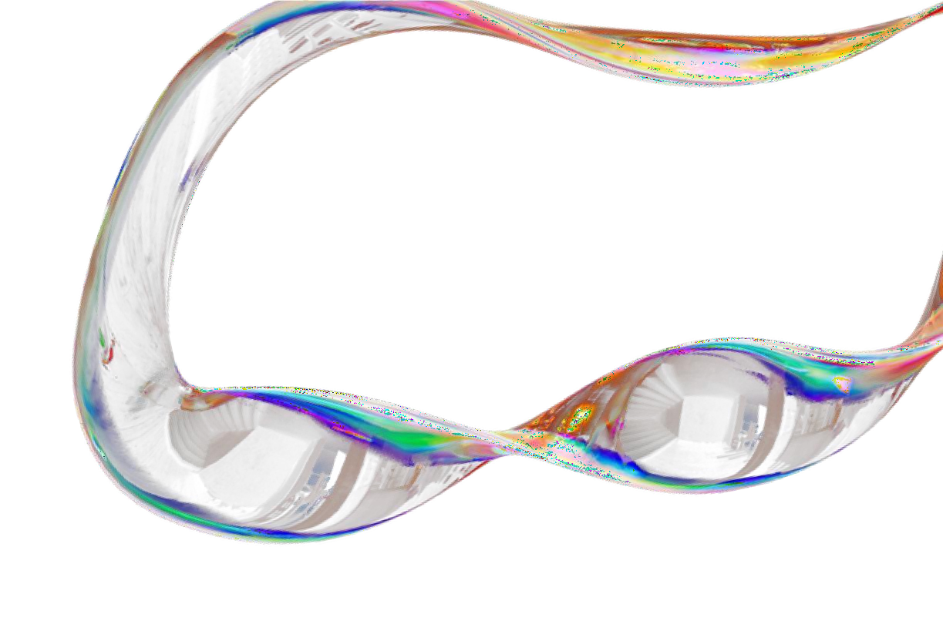






OUR SOLUTION
EYE-CATCHING SMART VENDING MACHINES
SOFTWARE DEVELOPMENT WITH GAMIFICATION AND FOCUS ON SALES
ADDITIONAL MONETIZATION THROUGH DIGITAL MEDIA
& PARTNERSHIPS

Slide 4

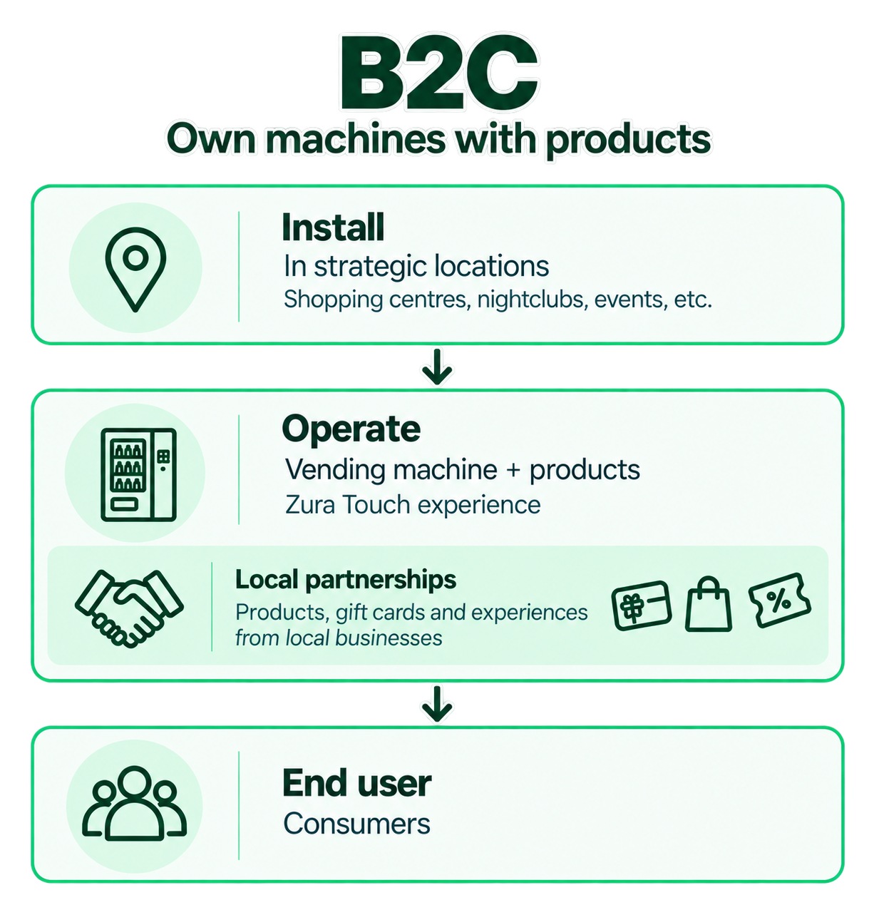

Monetization & Validation

Slide 5
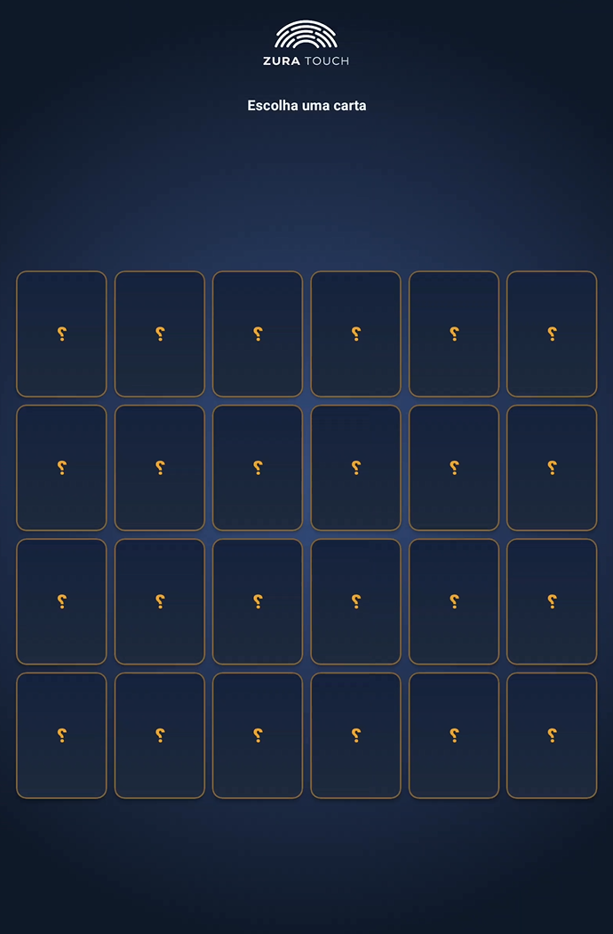

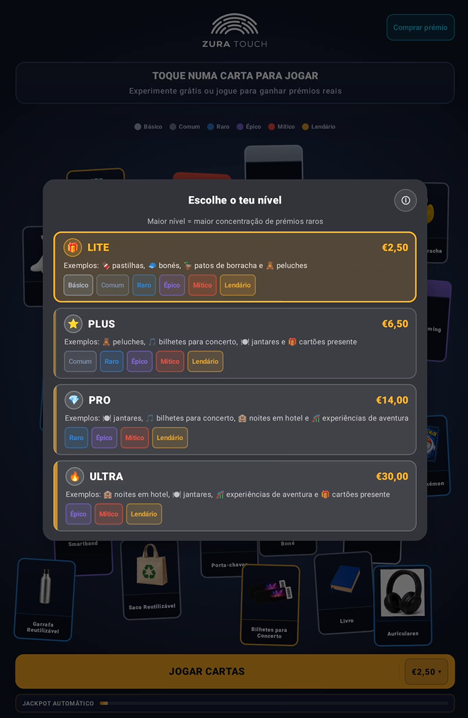
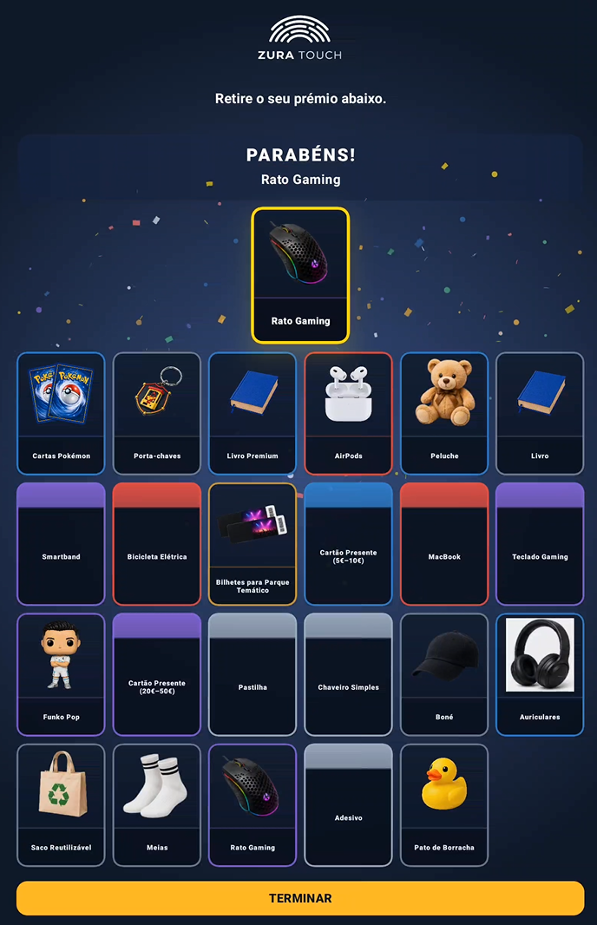
MVP DEMO

Slide 6

T H A NK
YOU
FOR YOUR TIME AND ATTENTION

